Slide 1




Bank client’s payment default Report
View in Power BI
Last data refresh:
2/17/2020 10:28:29 AM GTB Standard Time
Downloaded at:
2/21/2020 2:22:26 PM GTB Standard Time

Slide 2
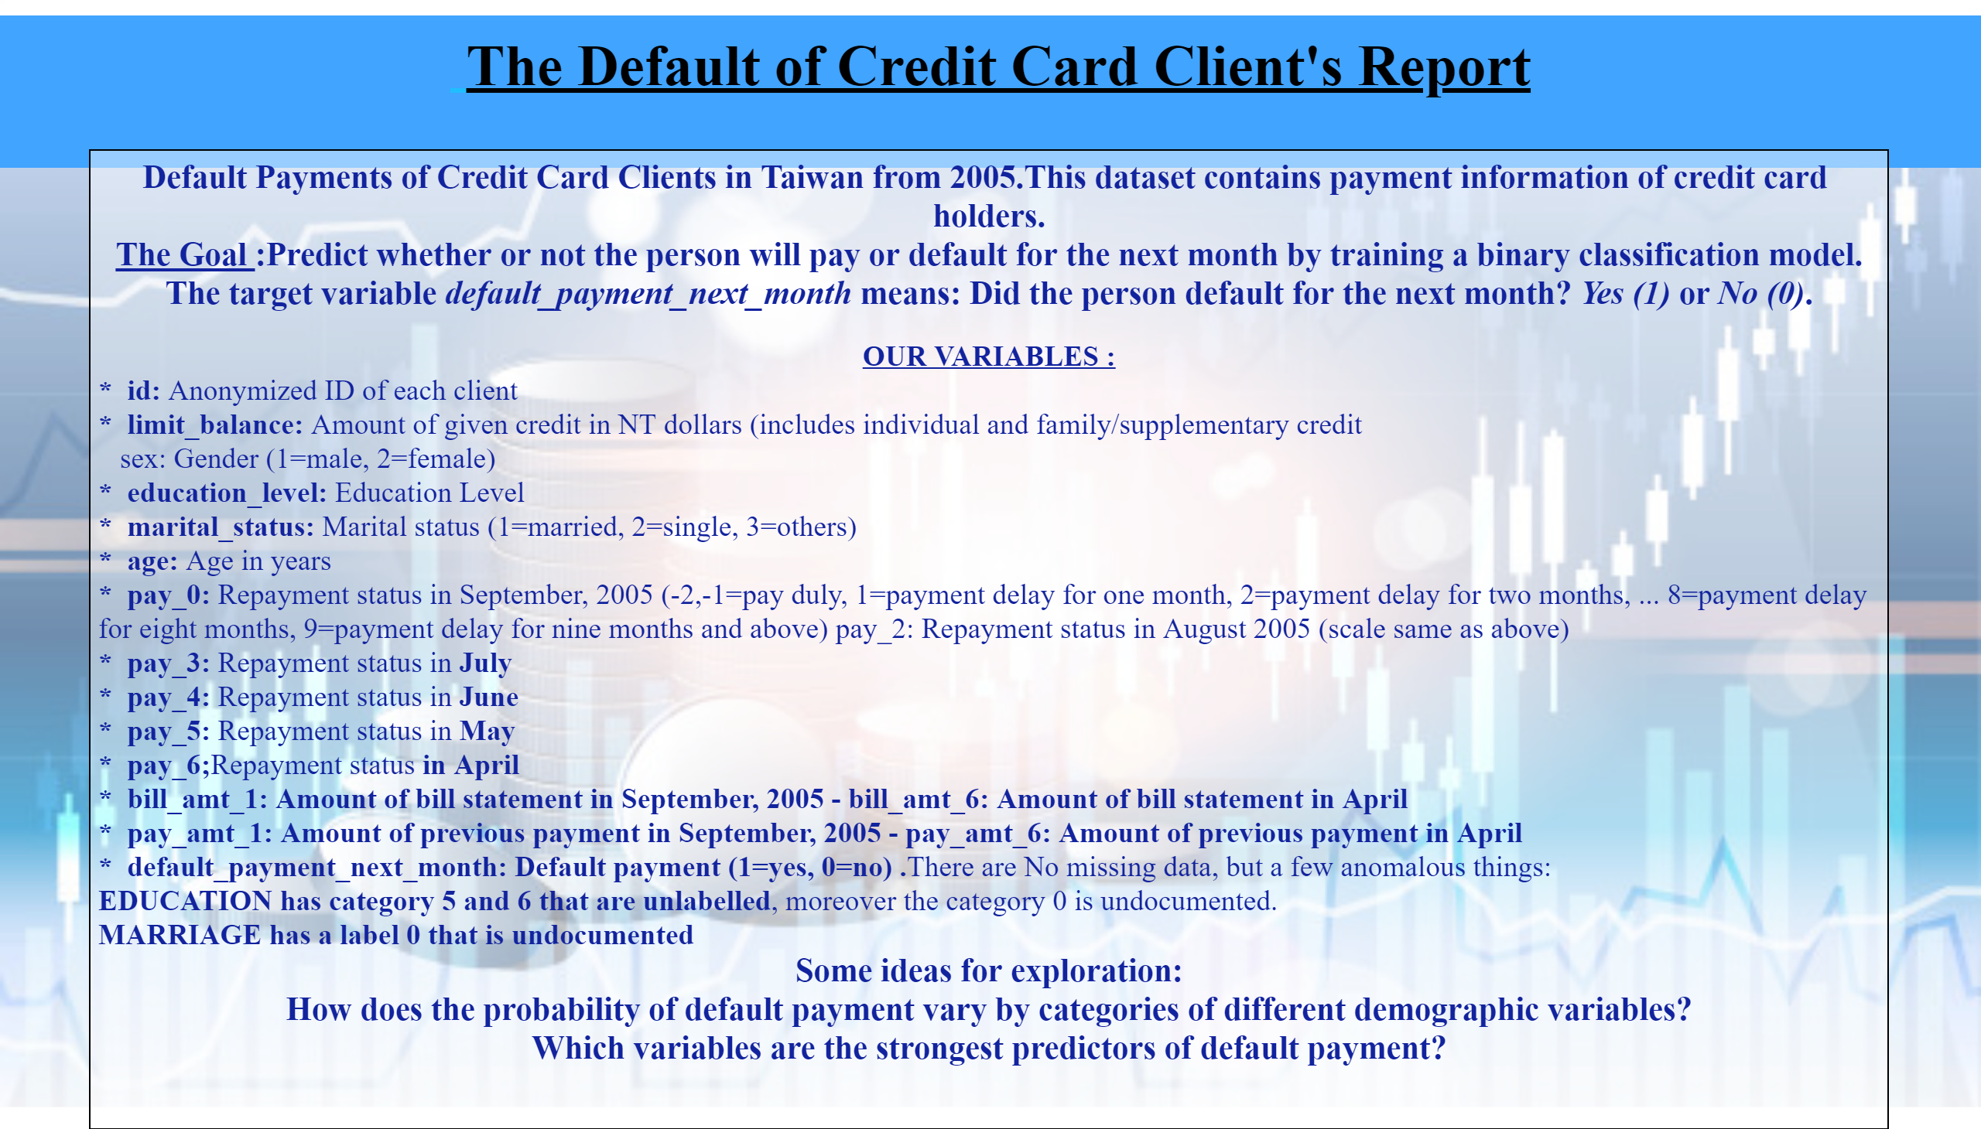

Slide 3
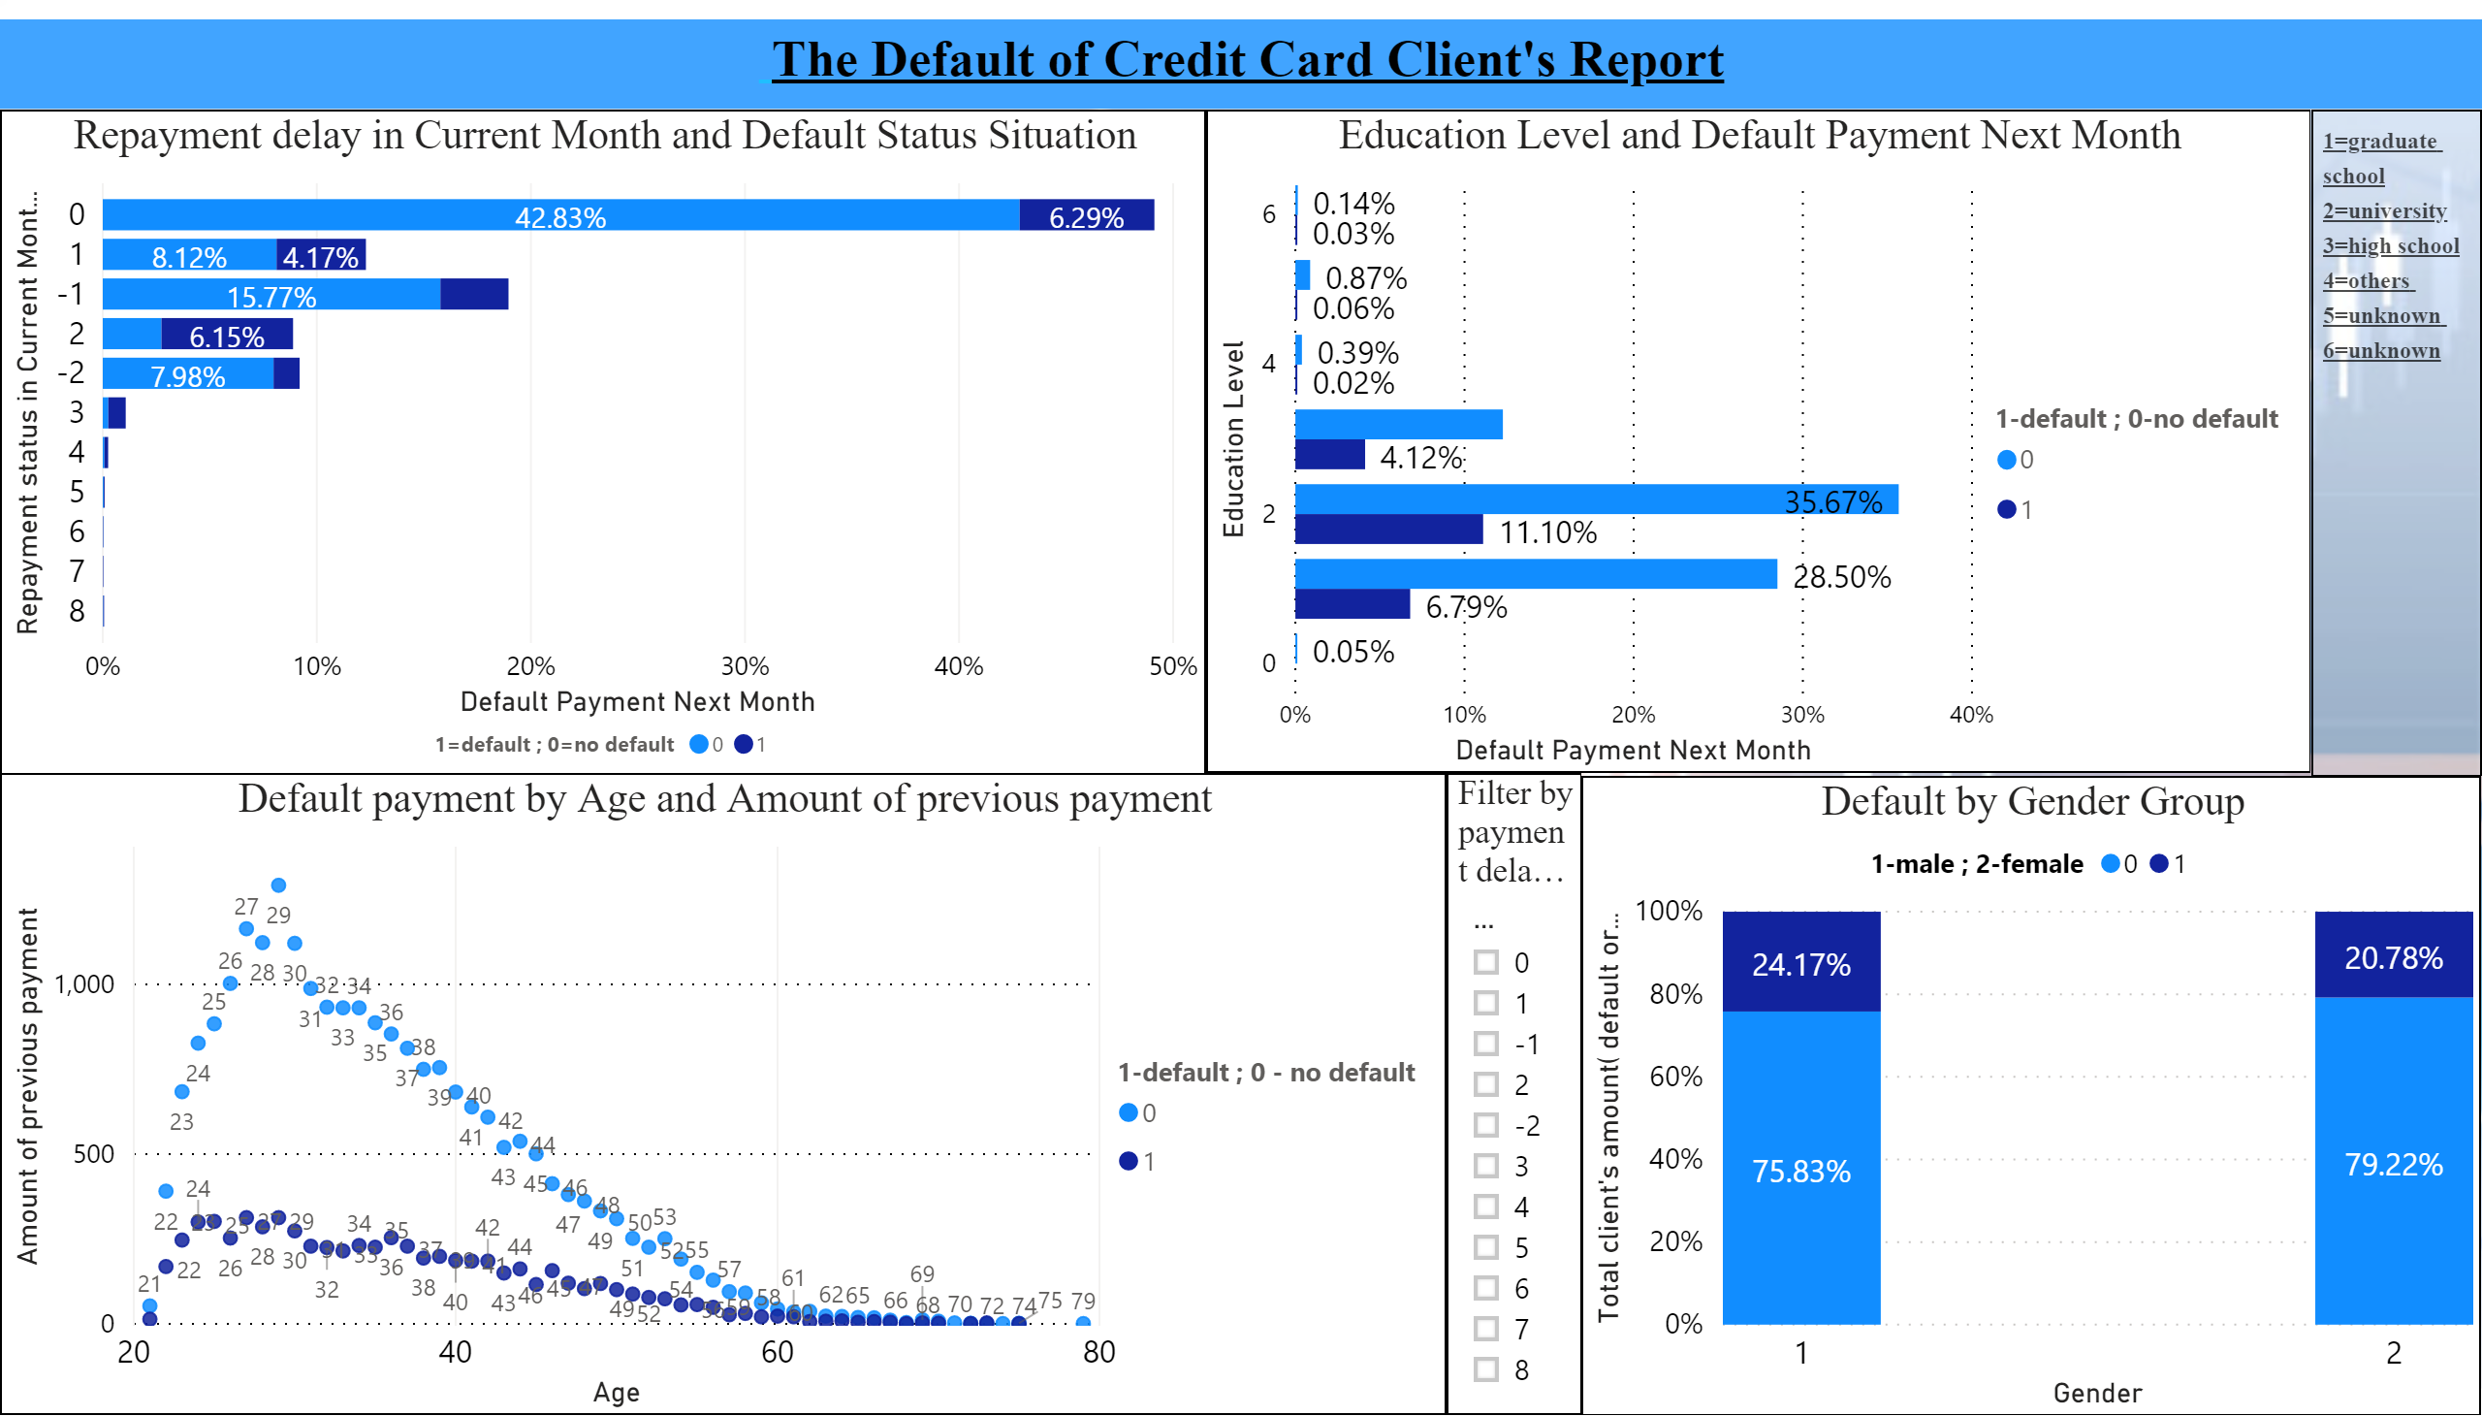

Slide 4
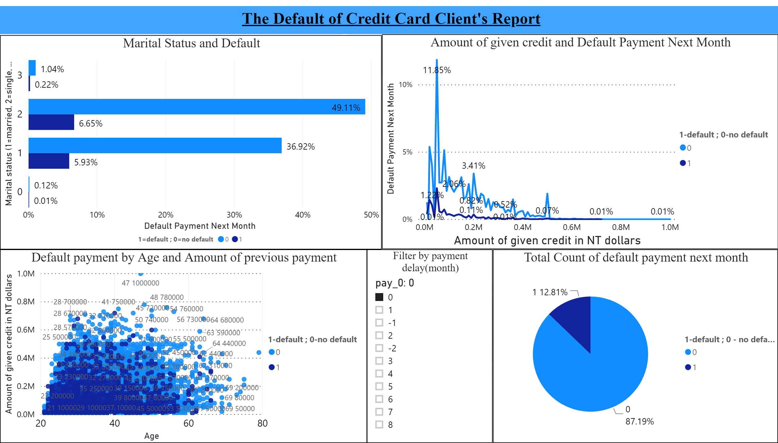

Slide 5
